Slide 1
Integrating Tools, Engines and Metadata Repositories into the Open Metadata Standards
1st February 2018

Slide 2
Agenda
Why open metadata?
What type of technology can use open metadata.
Integration patterns
Reference implementation modules
Integrating tools and engines
Integrating metadata repositories
Open metadata repository cohorts
Using the adapter pattern
Becoming a native
Summary

Slide 3
Why do we need metadata?
Metadata enables data to be used outside of the application that created it.
Analytics and decision making
New business applications
Reporting and compliance
Metadata describes the format and content of data allowing people to judge which data set to use for a new project
Structure
Meaning
Origin
Valid values and quality
Usage and ownership
Regulations and classifications that apply
<more>

Slide 4
Today’s reality

Slide 5
What needs to change?
Open and
Unified Metadata

Slide 6
A new manifesto for metadata and governance
Metadata management must be automated
Metadata management must become ubiquitous
Metadata must become open and remotely accessible
Metadata should be used to drive the governance of data
The discovery, maintenance and user of metadata has to be an integral part of all tools that access, change and move information.
6
Notes:
The maintenance of metadata must be automated to scale to the sheer volumes and variety of data involved in modern business.
Metadata management must become ubiquitous in cloud platforms and large data platforms, such as Apache Hadoop so that the processing engines on these platforms can rely on its availability and build capability around it.
Metadata access must become open and remotely accessible so that tools from different vendors can work with metadata located on different platforms. This implies unique identifiers for metadata elements, some level of standardization in the types and formats for metadata and standard interfaces for manipulating metadata.
Metadata should be used to drive the governance of data and create a business friendly logical interface to the data landscape.
Wherever possible, discovery and maintenance of metadata has to an integral part of all tools that access, change and move information.

Slide 7
Metadata and governance digital platform
Governance Platform
Analytics Platform
Reporting Platform
Open Metadata and Governance
Data Platform
ETL Platform
Virtualization Platform

Slide 8
Which technologies integrate with open metadata?
Engines
Data Integration and Movement
Data Virtualization
Data Security
DevOps Pipeline
Test Data Managers
Archive/retention managers
Tools
Governance tools
Data Science tool
Developer tools
Data quality tools
Data curation tools
BI Tools
Data architecture tools
Metadata repositories
Data Set Providers (eg Open Data sites)
Cloud platforms
Metadata driven tools

Slide 9
Examples

Slide 10
Open Metadata Repositories
Mobile Apps
Open Metadata Repository Cohort
Data Lake
Databases
Files
Applications
Notes:
Legend and numbering

Slide 11
Open Metadata Repositories
Mobile Apps
Independent Open Metadata Repository
Open Metadata Repository Cohort
Data Lake
Databases
Files
Applications
Notes:
Legend and numbering

Slide 12
Apache Atlas http://atlas.apache.org/
Apache Atlas has just graduated to become a top-level project.
It began as an incubator open source project on 5th May 2015 to deliver an open source governance capability focused primarily on the Hadoop platform.
Apache Atlas is designed to localize operational governance to the operating data platform such as Hadoop.
At its heart is a type-agnostic metadata store that can be access through restful interfaces.
We see Apache Atlas as the reference implementation for open metadata and governance, for vendors to pick up and use; or test their integration against.
Being open source allows all vendors to enrich/enhance standard.

Slide 13
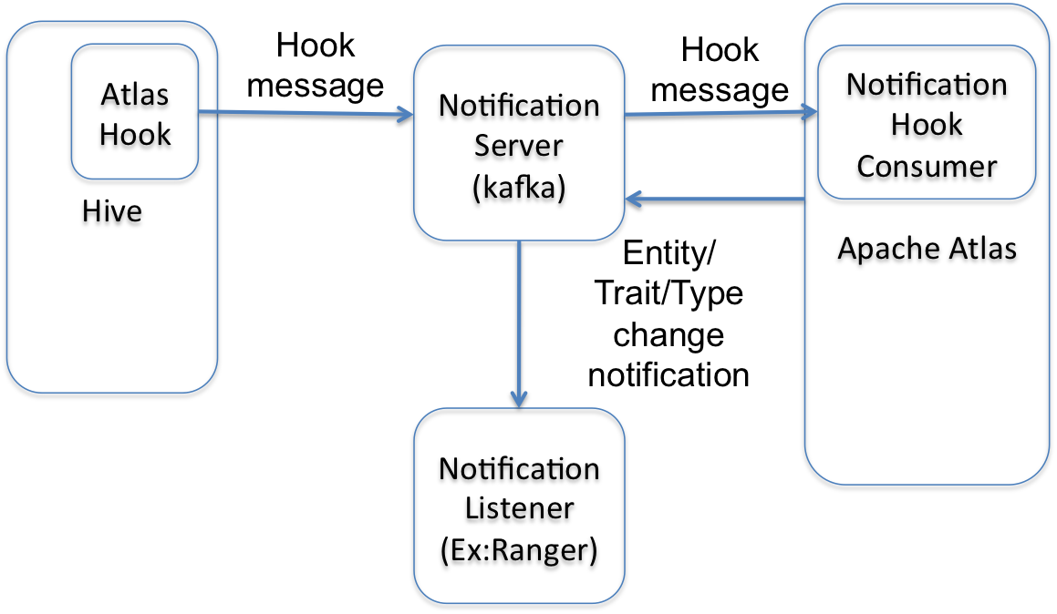
Apache Atlas today

Slide 14
Updates to Apache Atlas
Automation
Capture of metadata from data platforms, data movement engines and data protection engines.
Exception management and stewardship
Business Value
Specialized services for key data roles such as CDO, Data Scientist, Developer, DevOps Operator, Asset Owner, Applications
Connectivity
Metadata Highway offering open metadata exchange, linking and federation between heterogeneous metadata repositories.

Slide 15
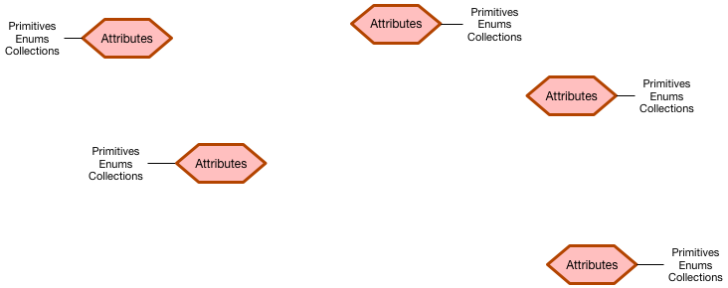
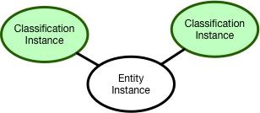
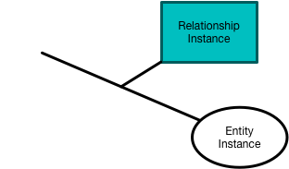
Instance representations in the graph

Slide 16
Open metadata meta-types, types and instances

Slide 17
Open metadata type model summary
Strategy
4
Subject Area Definition
1
Teaming Metadata
(people profiles, communities, projects,
notebooks, …)
Policy Metadata (Principles, Regulations, Standards, Approaches, Rule Specifications, Roles and Metrics)
Business Objects and Relationships, Taxonomies and Ontologies
Augmentation
3
Organization
Feedback Metadata
(tags, comments, ratings, …)
Rollout
Classification
Business Attributes
Campaigns and Projects
Classification Schemes
Implementation
Mapping
Governance Actions and Processes
Rights
Management
Models and Schemas
2
Asset Collections
(Sets, Typed Sets, Type Organized Sets)
Reference Data
5
Instrument
7
Information Process
Instrumentation (design lineage)
Association
Information Views
Augmentation
Discovery
Metadata (profile data, technical classification, data classification,
data quality assessment, …)
Physical Asset Descriptions
(Data stores, APIs,
models and components)
0
Basic Types, Infrastructure and Systems
Access
6
Connectors

Slide 18
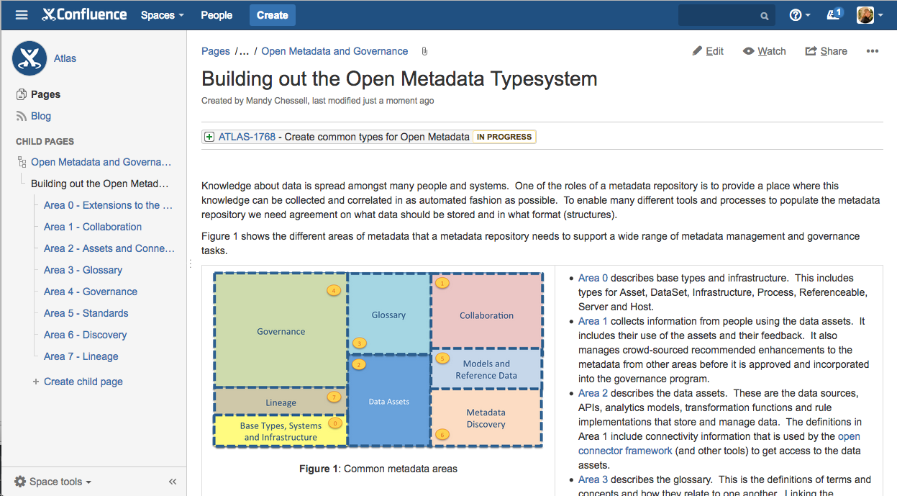
More detail here … https://cwiki.apache.org/confluence/display/ATLAS/Building+out+the+Open+Metadata+Typesystem

Slide 19
Apache Atlas – reference implementation

Slide 20
Integration patterns
https://cwiki.apache.org/confluence/display/ATLAS/Integrating+into+the+Open+Metadata+and+Governance+Ecosystem

Slide 21
Caller Pattern
A metadata tool or engine can access the consumer-specific APIs to work with metadata.
The Access Layer handles the calls to metadata repositories connected to the metadata highway

Slide 22
Adapter Pattern
Simple components plug into a repository proxy to connect in an existing metadata repository.

Slide 23
Native Pattern
Native implementation of the open metadata governance APIs
Apache Atlas is a native implementation of the open metadata and governance APIs.

Slide 24
Communicating as a cohort

Slide 25
Using multiple cohorts

Slide 26
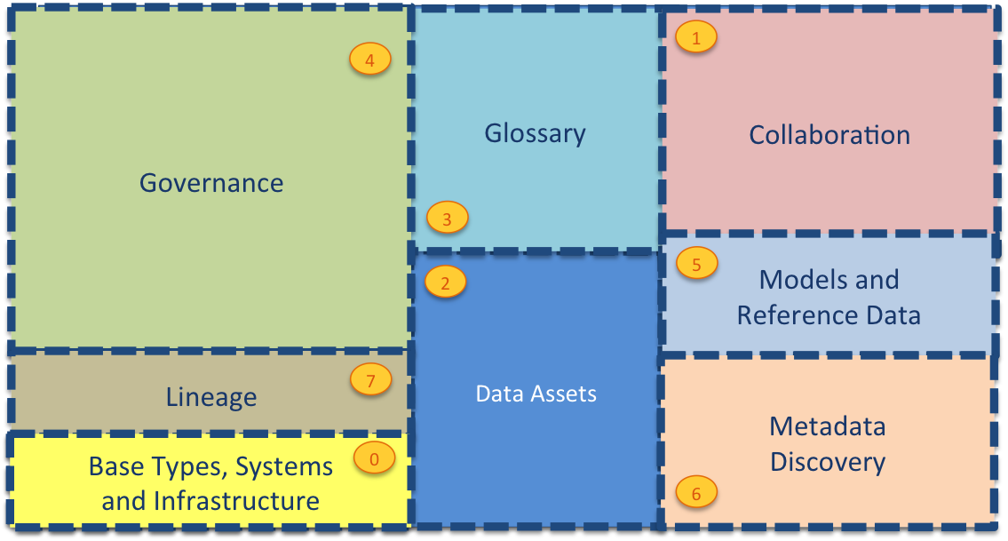
Open Metadata Access Services
Asset Owner
Subject Area
Information View
Asset Catalog
Community Profile
Stewardship
Project Management
Governance Program
Data Science
Information Process
Developer
Information Protection
Information Landscape
Governance Engine
DevOps
Information Infrastructure
Data Platform
Connected Asset
Asset Consumer
Discovery

Slide 27
Inside the server

Slide 28
Inside the server

Slide 29
First server

Slide 30
Establishing contact

Slide 31
Federated queries

Slide 32
Caching metadata for availability and performance

Slide 33
Implementing the Adapter Pattern
Open Metadata and Governance

Slide 34
Metadata Type System

Slide 35
Open metadata meta-types, types and instances

Slide 36
Open metadata type model summary
Strategy
4
Subject Area Definition
1
Teaming Metadata
(people profiles, communities, projects,
notebooks, …)
Policy Metadata (Principles, Regulations, Standards, Approaches, Rule Specifications, Roles and Metrics)
Business Objects and Relationships, Taxonomies and Ontologies
Augmentation
3
Organization
Feedback Metadata
(tags, comments, ratings, …)
Rollout
Classification
Business Attributes
Campaigns and Projects
Classification Schemes
Implementation
Mapping
Governance Actions and Processes
Rights
Management
Models and Schemas
2
Asset Collections
(Sets, Typed Sets, Type Organized Sets)
Reference Data
5
Instrument
7
Information Process
Instrumentation (design lineage)
Association
Information Views
Augmentation
Discovery
Metadata (profile data, technical classification, data classification,
data quality assessment, …)
Physical Asset Descriptions
(Data stores, APIs,
models and components)
0
Basic Types, Infrastructure and Systems
Access
6
Connectors

Slide 37
More detail here … https://cwiki.apache.org/confluence/display/ATLAS/Building+out+the+Open+Metadata+Typesystem

Slide 38
Repository Connectors

Slide 39
Implementing the Caller Pattern
Open Metadata and Governance

Slide 40
Open Metadata Access Services
Asset Owner
Subject Area Expert
Information View
Asset Catalog
Community
Stewardship
Project Management
Governance Program
Data Science
Information Process
Developer
Information Protection
Information Landscape
Governance Engine
DevOps
Information Infrastructure
Data Platform
Connected Asset
Asset Consumer
Discovery

